Slide 1
Model Decomposition Visualization for Subtractive Prototyping
David Peiffer

Slide 2
Outline
Intro to Research Project
Concept Pictures
Actual Implementation
Plans for Submission

Slide 3
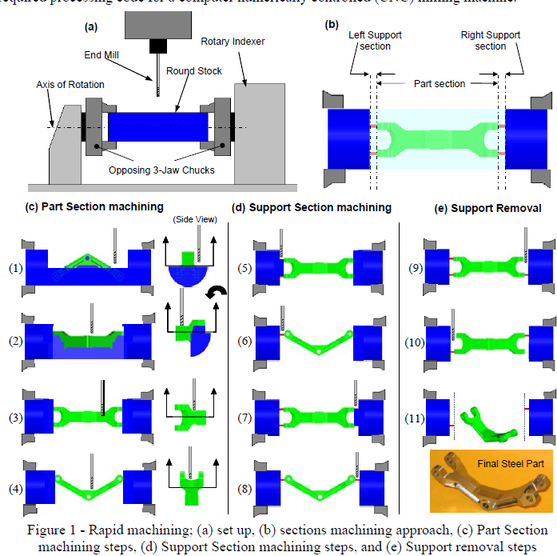
Introduction
CNC-Rapid Prototyping (CNC-RP) is subtractive manufacturing of parts
Part is rotated until all surfaces have been machined
Depends on axis selection for visibility
Implementing Rapid Prototyping Using CNC Machining (CNC-RP) Through
a CAD/CAM Interface, Frank 2007

Slide 4
CNC-RP vs. Traditional CNC Machining
Pros
Cons
Toolpaths are automatically created
Saves many hours to days of skilled labor time
Automated setup changes
Surface finish is as good as you want it
Some geometries cannot be manufactured
Manufacturing process is slow compared to full production

Slide 5
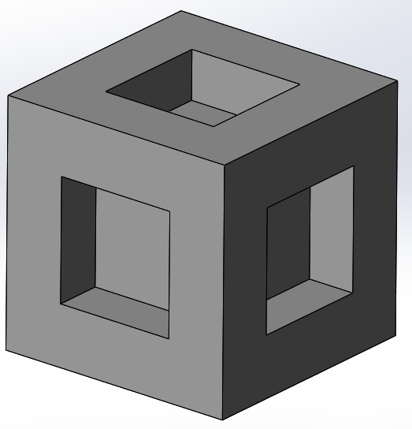
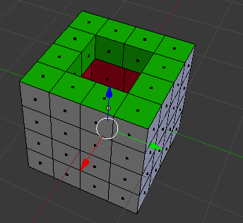
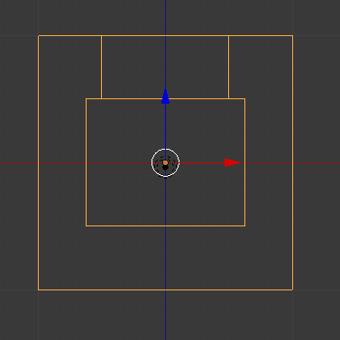
CNC-RP Failing Geometry
Undercut features (requires line of sight from tool)
Features not perpendicular to an axis of rotation
Notes:
On the left we have undercut features. The red colored rectangles are not accessible with traditional machining processes.
On the right, we have three features which are perpendicular. The sides of the pockets can only be touched with a tool which is perpendicular to the pocket. This would require three setup orientations, as seen by the arrows. A limitation of the process is that you must rotate the entire model around a single axis. Picking one of the arrows as an axis, we are unable to manufacture that face.
If there was a way to break the part into multiple smaller pieces, each of which fit the criteria for CNC-RP manufacturing, they could be reassembled at the end.

Slide 6
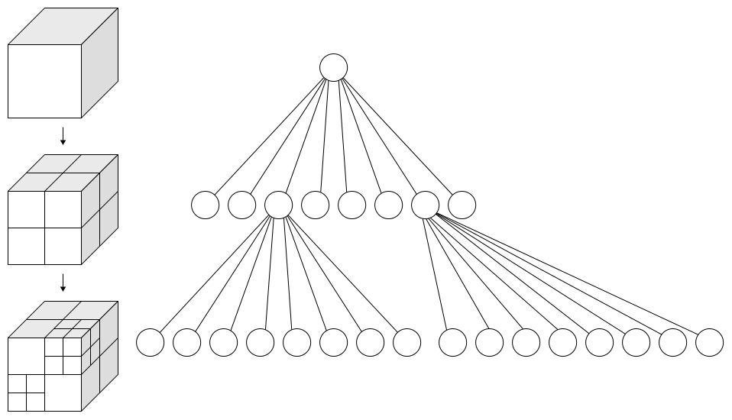
Octree Decomposition
Start with original model
Cut model in half on x, y, and z midplanes
Continue until stopping condition
Typically size or attribute of cube
In this case, it’s a Boolean (CNC-RP manufacturable?)
By WhiteTimberwolf, PNG version: Nü - Own work, CC BY-SA 3.0, https://commons.wikimedia.org/w/index.php?curid=9851485
Notes:
There are a variety of ways which could be used to break the assembly up. One is octree decomposition. A model is broken into smaller chunks, and this continues until we meet criteria to stop subdividing. In this case, we want each chunk to be manufacturable by CNC-RP individually. Once this is achieved, we can look at the possibility of combining some pieces together so we don’t end up with lots of small pieces.

Slide 7
Implementation Goals
Visualize the process of cutting the part into chunks
Allow user interaction to select chunks for separation
Animate movement between

Slide 8
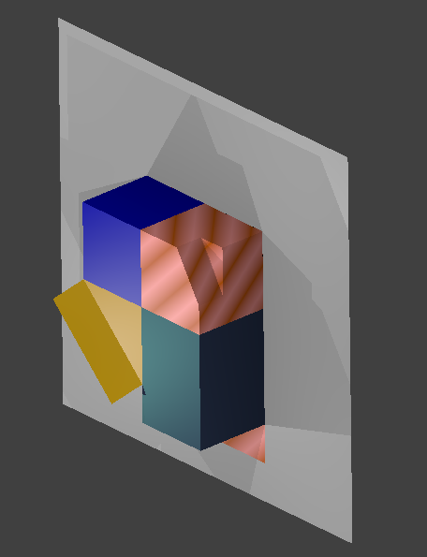
Concept – Cutting Plane
User selects cutting plane
Keyboard input x, y, or z
Cutting plane appears
User confirms choice by hitting the same button again

Slide 9
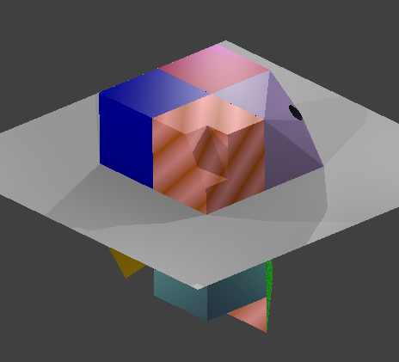
Concept – Cutting Plane
User changes selected cutting plane

Slide 10
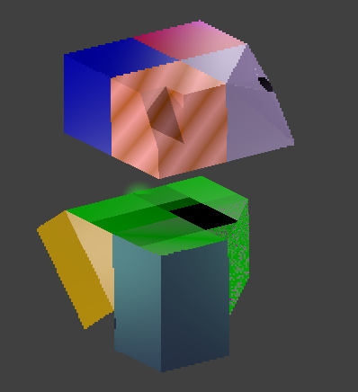
Concept – Cut model
User confirms cutting plane
Object is separated

Slide 11
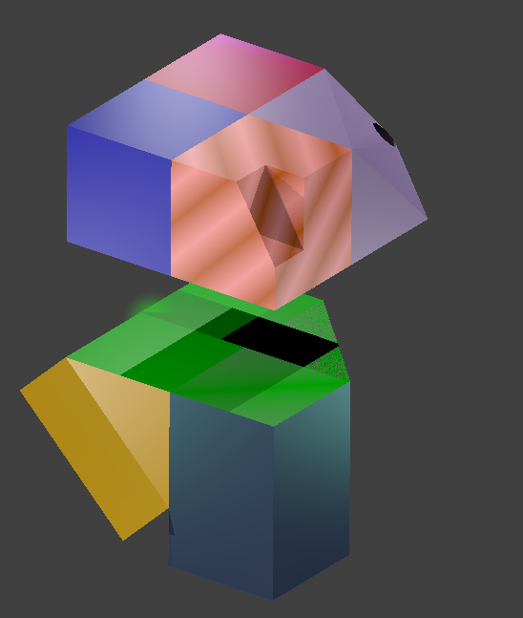
Concept – Selected item
Models are textured simply at first
When a portion of the model is selected, another texture will be added

Slide 12
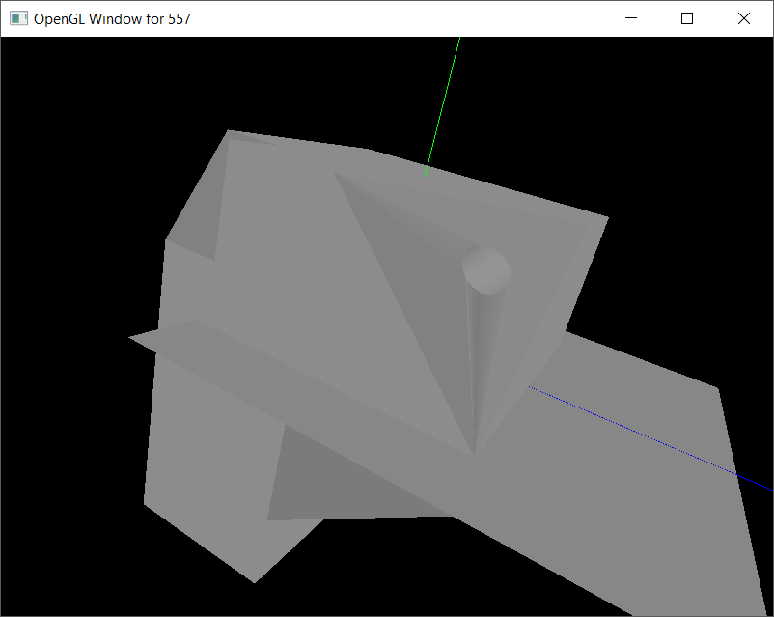
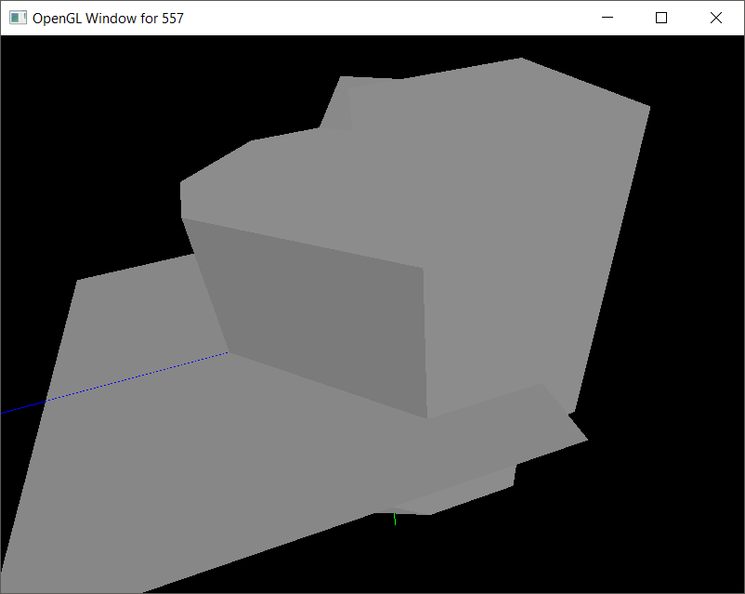
Current Progress
Notes:
Currently I have .obj models loading, but am running into some challenges going from here:
The textures I have made are not being applied to the objects. Textures are .bmp files, and the texture coordinates were mapped in Blender.
I have checked the .obj files I’m generating against the files used in the class examples, and they have the same attributes.

Slide 13
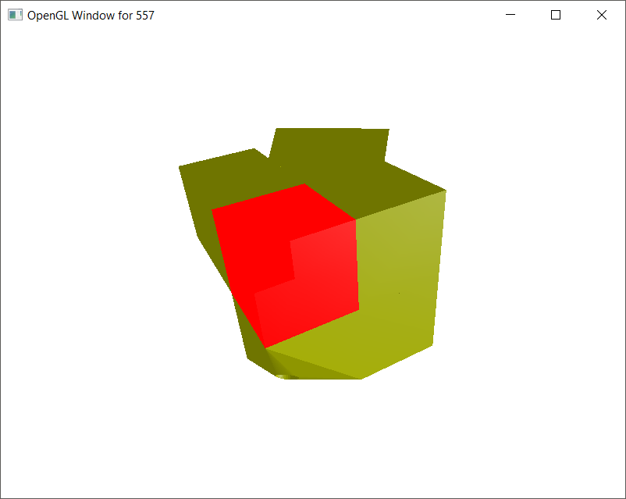
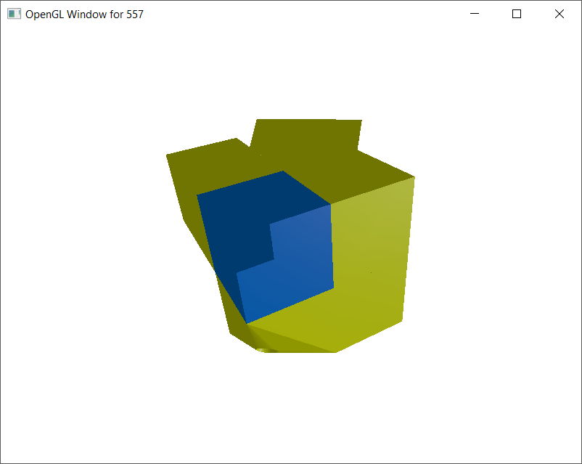
Current Project

Slide 14
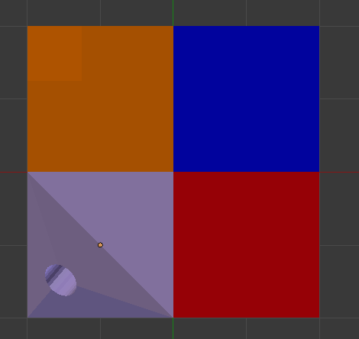
Animation of Translations
Each model gets a translation vector
If multiple models are selected
Add the translation vectors

Slide 15
Project Experience
Difficulty combining concepts
Limited prior programming experience
Debugging takes a long time
OpenGL gives little in the way of feedback when you make mistakes
Notes:
I’m not the strongest programmer in the room, and it has been a struggle at times. I have a lot of work left to do, but I think I will be able to get most of the intended functions working together.
Debugging problems is a particular weakness, which is slowing progress down significantly. For example, in Homework 4, I had a typo which prevented my program from working. That took multiple hours to figure out.

Slide 16
Questions?

